Slide 1


Henan normal University
Introduction to team members

Slide 2

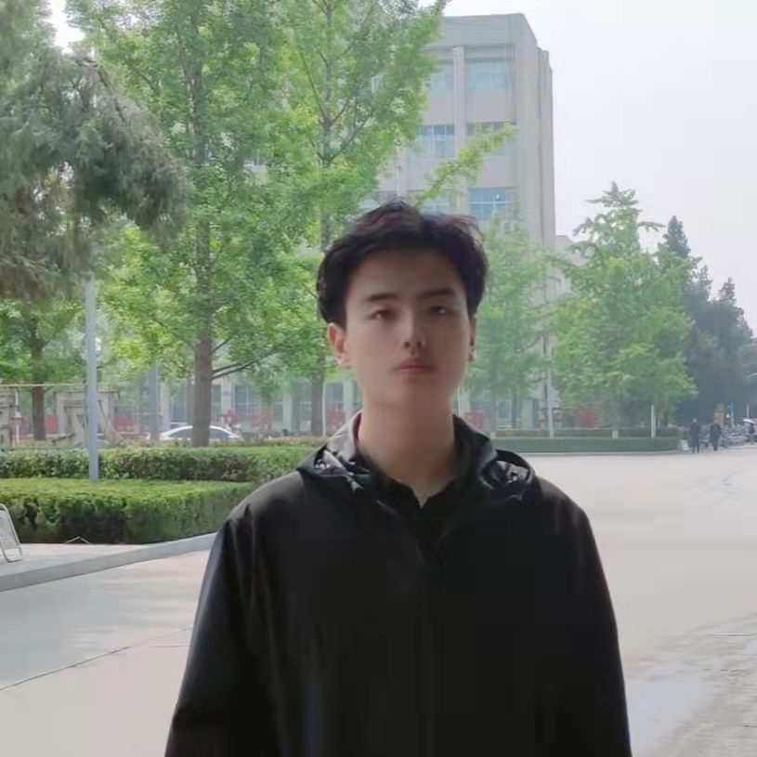



Name : Li Hao 李灏
Team role：Captain and Mainly responsible for requirements analysis and testing
Hometown：Xu chang in Henan province
Major：Software Development (Java)
Basic attributes：Honest and reliable
Hobby：Swimming
Motto：Will is power.
WeChat ：15290920929
T
Trello ID：1131348051
Email：l1928424094@126.com

Slide 3
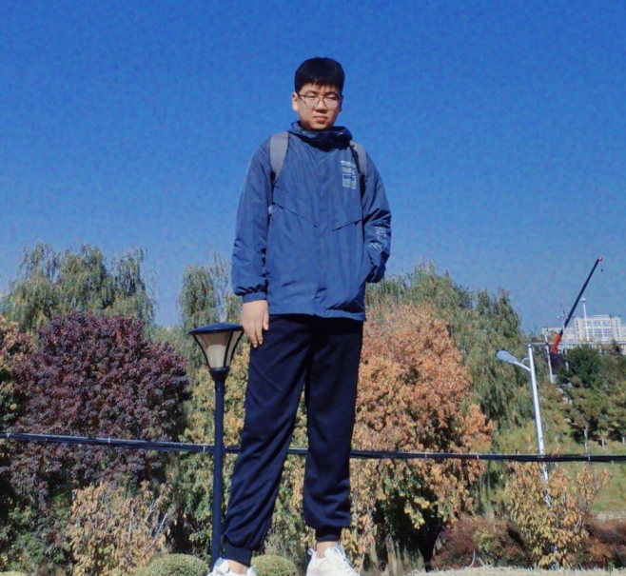
Name：Zhao Yuanxin 赵圆鑫
Team Role：UI Design Front end development
Hometown：Xu chang in Henan province
Major：Computer science and technology
Development Ability：Java html css js
Basic attributes：Cheerful, modest and confident
Hobby：Basketball reading E-sports
Motto：Practice makes perfect.
WeChat：
ZYX2001-08-07
T
Trello ID：
zhaoyuanxin
Email：
zyx_2001_0807@126.com

Slide 4
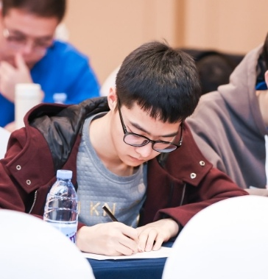
Name：Fan Yilin 范怡林
Team Role：UI Design
Age：21
Development Ability：Java, MySQL, and Angular
Project Experience：Internet media management system
Major ：Computer Science and Technology
Hobby ：Jogging
Other Preferences：Find Interesting Open Source Projects on Github
Motto：Later equals never.
WeChat：fylin-6
T
Trello ID：fylin6
Email：fylin6@126.com

Slide 5
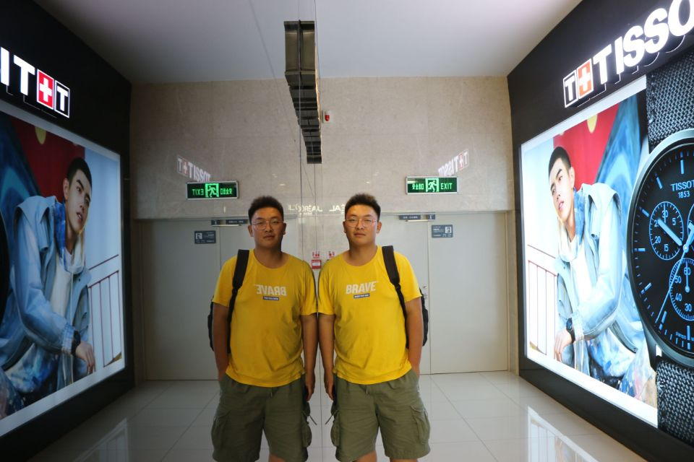
Name： Ma Pengxuan 马朋轩
Team Role : Project development
College: the Software College of Henan Normal University
I have interest of project developing. But sometimes I may be lack of my own judgments. Treating something may be not objective because of the little experience.I am lively, sunshine and optimistic to my life, so it’s very easy to get alone well with me. As for this exchange to , I think that it’s a good chance for me, it can give me a good opportunity to study and communicate. It can provide us good experience and exercise. It also can broaden my outlook. What’s more, because I am independent and can take good care of myself.
Motto : One today is worth two tomorrows
WeChat：17744665589
T
Trello ID:unkonwn
Email:mpxuan6@126.com

Slide 6
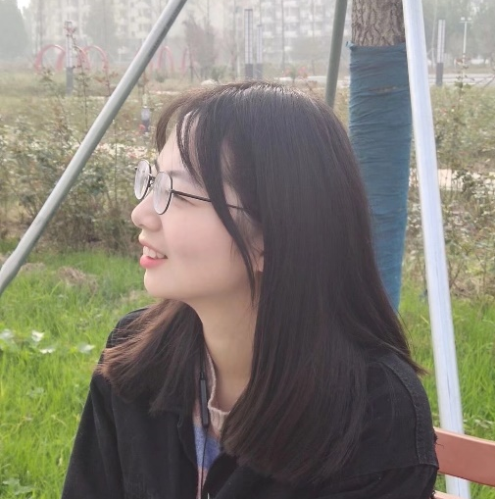
Name：Kong Wen 孔雯
Team role： Design interface
Hometown：Nan yang in Henan province
Major：Computer science and technology
Basic attributes：Humorous and outgoing
Hobby：Books , music , movies and running
Motto：Cheers to unknown
WeChat :kwup567
T
Trello ID:孔雯
Email:kw888_up@126.com

Slide 7
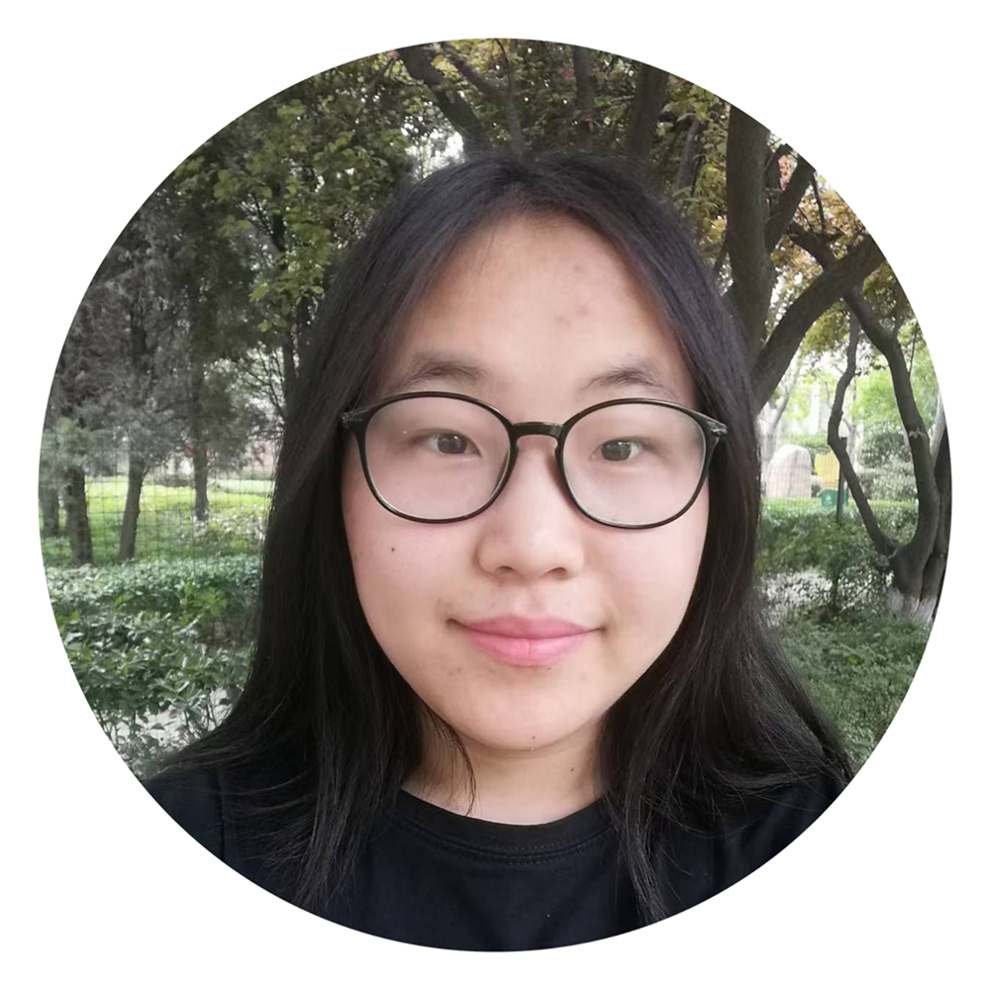
Name：Zhai Jiaqi 翟佳琪
Team Role : Front-end development
Major : computer science and technology
Hobby : reading novels
Address : Luoyang, Henan Province
Motto：Nothing is impossible, only the unexpected
WeChat : Jiaqi-Tracy
T
Trello ID : Jiaqi Zhai
Email:zjq_678jy

Slide 8
vielen dank！

